Slide 1



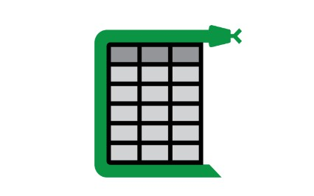

Workflow:
Passing page one by one to camelot and layout parser
Layout Parser
(Detect the table from pdf).
Passing table Coordinates
Match if keywords are present, If yes store tha table in png format.
Camelot (Extract table from pdf) and store it in form of pandas dataframe
Check if the table has stats if yes then go to next step

Slide 2
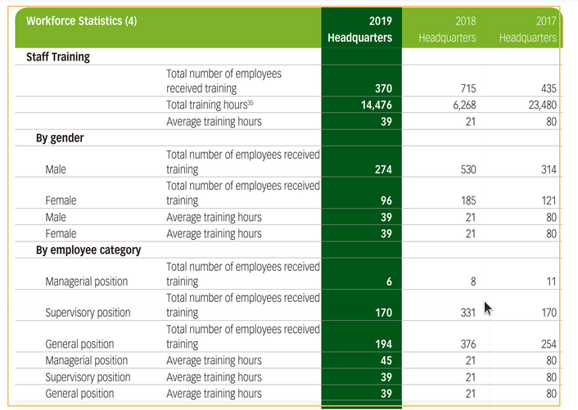
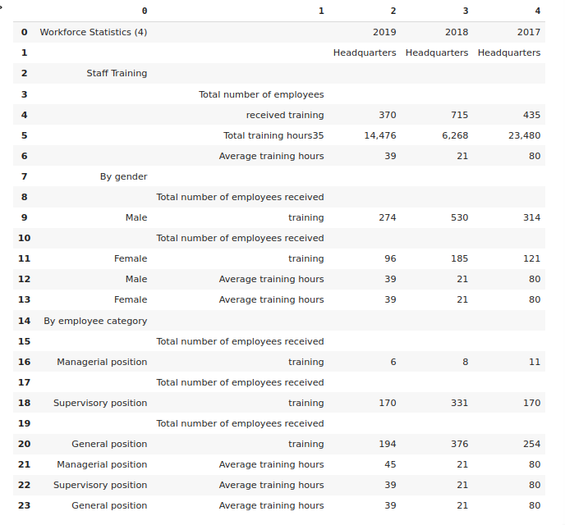
Tech Stack used:
1) Layout Parser
A unified toolkit for Deep Learning Based Document Image Analysis which can detect tables from the pdf.
2) Camelot
A python library that extract tables from PDFs

Slide 3
Python library that extract tables from PDFs
Camelot

